Slide 1
Reports and Dashboard

Slide 2
Objective
At the end of the session, you will be able to:
Understand what is report
Understand different types of Report
Configure custom report
Understand different report options
Understand Chart Options / Types
Create Custom Report Type
Understand what is dashboard
Create new Dashboard

Slide 3
Reports
Reports are of two types
Standard report
Normal reports which gives you the detail analysis of account, contact, opportunity like objects
Can be modified to create custom reports
May not be deleted but folder can be hidden
Need to save in a standard folder
Can not use report search functionality to search standard report
Custom Reports
Salesforce.com comes with a huge menu of useful reports, and yet they might not be exactly what you're looking
if your company has added custom fields on the account record that are unique to your customer, a standard New Accounts report doesn't show you all the information you want to see on recent accounts.
May be edited or deleted
May not be saved in a standard folder
Can be searched for in custom report search

Slide 4
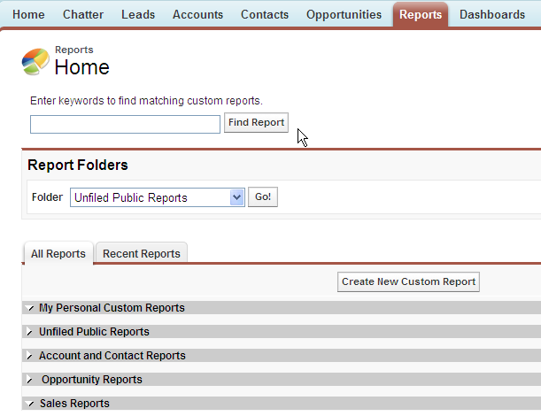
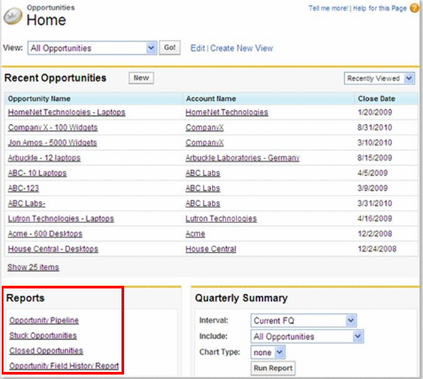
Reports Navigation
You can see the reports in Report tab and bottom of every object home page

Slide 5
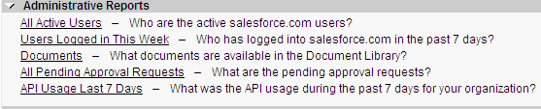
Administrative reports
Click Path : Report | Home
The All Active Users report lists the active users in your organization and when they last logged in.
The Users Logged in This Week report lists all of the users who have logged in to Salesforce in the past seven days.
The Documents report lists the documents within each document folder.
The All Pending Approval Requests report lists the approval requests awaiting approval for each approval process
API Usage Last 7 Days report list APIs usage during last 7 days for your organization

Slide 6
Report Type
Summery Report
Matrix Report
Tabular Report

Slide 7
Tabular Report
Simple table with rows and columns
It present data in simple rows and columns, much like a spreadsheet.
They don't contain groupings, but can be used to show column summaries, like sum, average, maximum, and minimum.
Enable floating report header property (available only with tabular report) TRUE to float header as scroll down the report
Click Path : Setup | customize | Reports & Dashboards | User Interface Settings
.

Slide 8
Summery Report
.
Simple table with rows and columns data with totaling and subtotaling of data
Display numbers as subtotal and total

Slide 9
Matrix Report
.
Summarizes data in a grid against horizontal and vertical criteria
Provide total for rows and columns
Is used for comparing groups

Slide 10
Custom Report Types
Click path : Setup | Create | Report types
A report type defines the set of records and fields available to a report based on the relationships between a primary object and its related objects
Allow you to build a framework in the report wizard, from which users can create and customize reports. You build custom report from the relationships (master-detail and lookup) between objects so that you can:

Slide 11
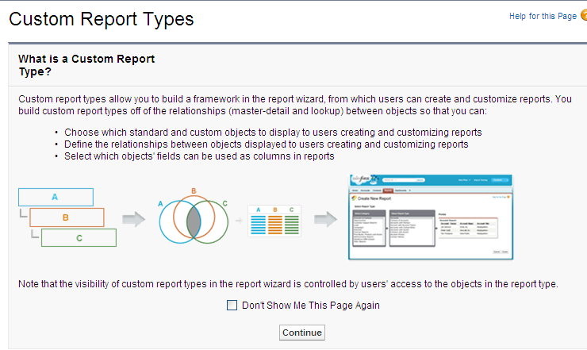
Steps to Create Custom Report Types
Click Setup | Create | Report Types, click on continue
Select the primary object, it determines the views available to users creating or running reports from your custom report type
Enter the Report Type Label and the Report Type Name field, Select the category to store the custom report type in.

Slide 12
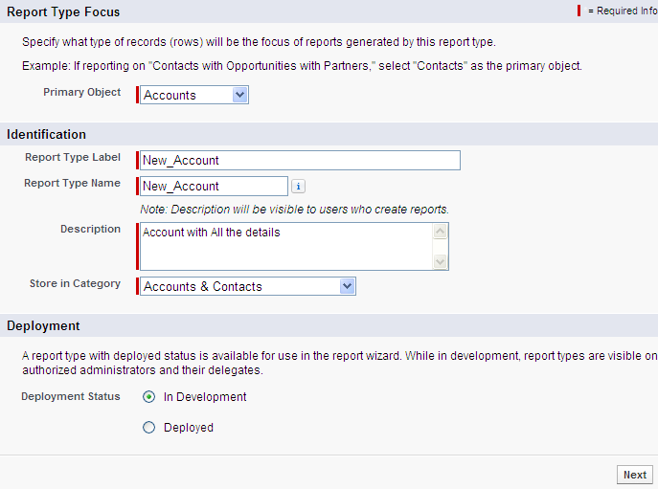
Steps to Create Custom Report Type
4) Select a development status:
Choose “In Development” as the Deployment Status which hides the custom report type and any reports created from it from all users except those with the “Manage Custom Report Types” permission.
Choose “Deployed” as the Deployment Status when you want to allow users to create and run reports from the custom report type.

Slide 13
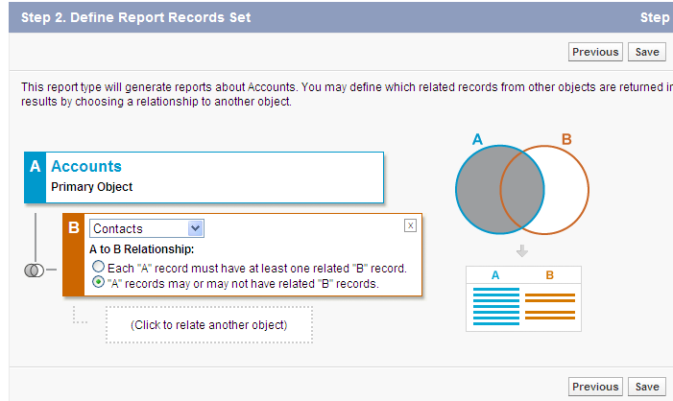
Steps to Create Custom Report Type
5) Define Report Records Set by selecting related object

Slide 14
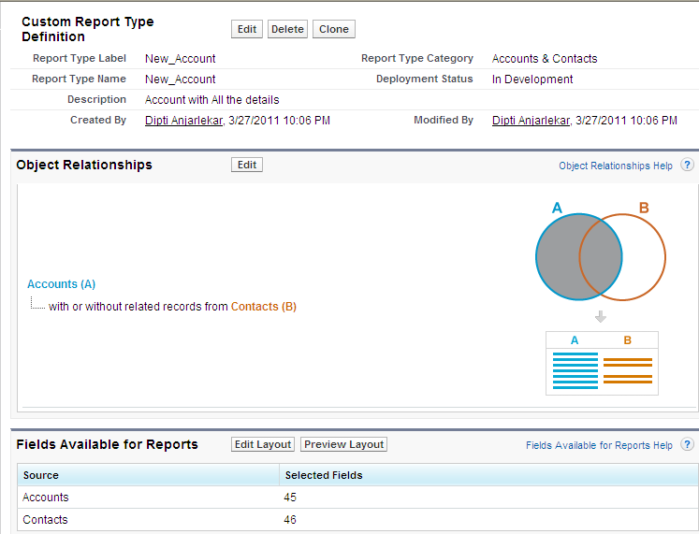
Steps to Create Custom Report Type
6) Click on save.

Slide 15
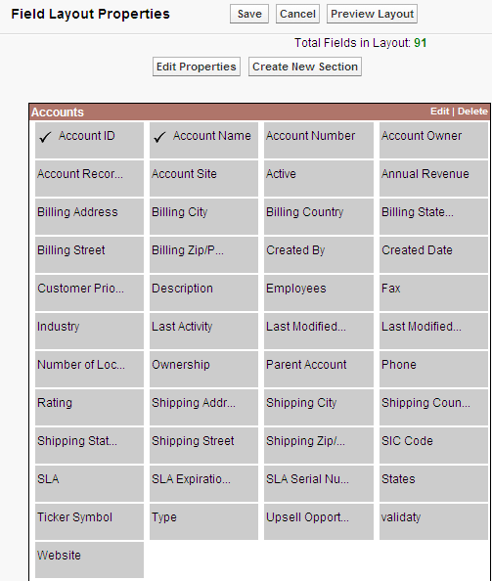
Steps to Create Custom Report Type
7) Edit field layout properties as per business requirement

Slide 16
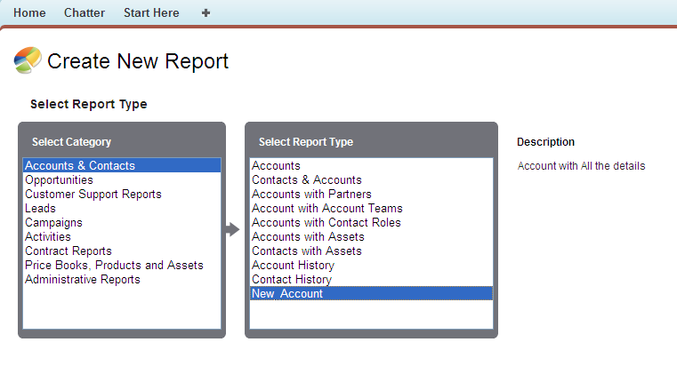
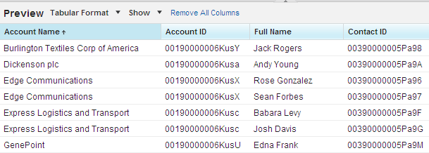
Steps to Create Custom Report Type
8) Now report is available in use with the customized default properties

Slide 17
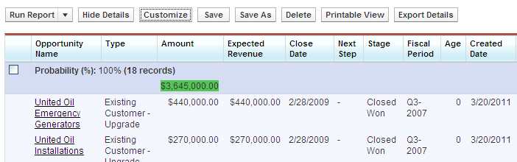
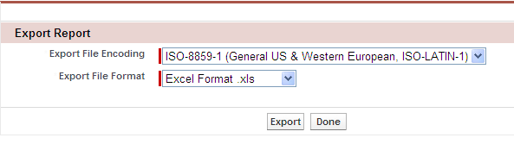
Report Options
Click on Customize button to customize the report and save it again
Click Export Details to export report to specific destination.
You can export upto 256 columns and 65536 rows of data

Slide 18
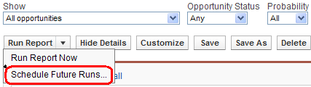
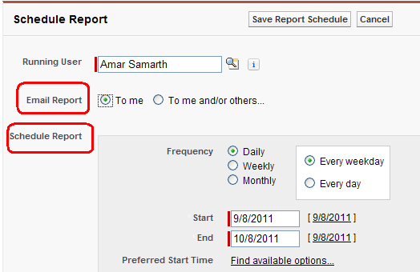
Report Options- Scheduling and Emailing Report

Slide 19
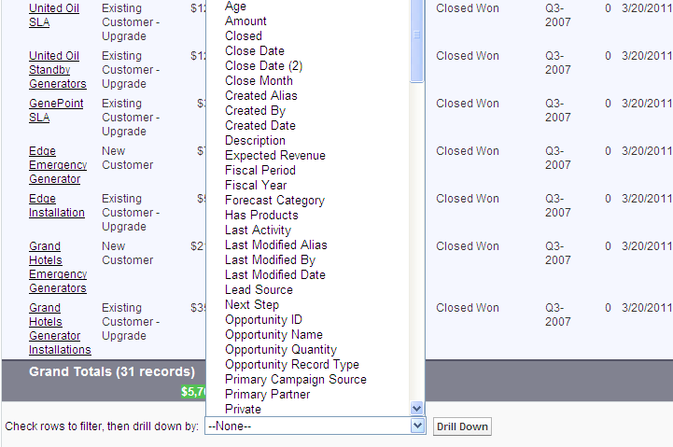
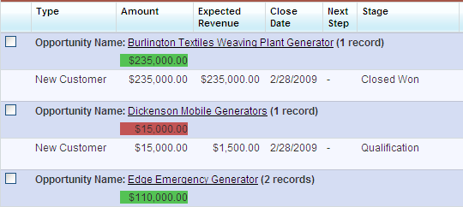
Report Options
Filter and drill down on field by selecting fields from drop down

Slide 20
Thank you
Visit us at www.techmahindra.com

